Slide 1
Standardised Trust
Digital Future for Trade Finance
Community presentation
www.standardisedtrust.com

Slide 2
Vision & Mission
The Standardised Trust is global and independent community actively co-operating and contributing towards digitalisation in global trade
Standardised Trust will co-operate with banks, corporates, technology service providers, Fintechs, Emerging Techs, and regulators to advocate trade and supply chain finance towards digitalisation by exploring new technologies, new solutions, simplification, advanced ways of working, and digitalisation of existing processes and business models. The community is able to define renewed, modern, transparent and trusted business processes and solutions for the various trade and supply chain finance instruments supporting the global exchange of goods and services as well as business for banks, corporates, SMEs, and technology solution providers.

Slide 3
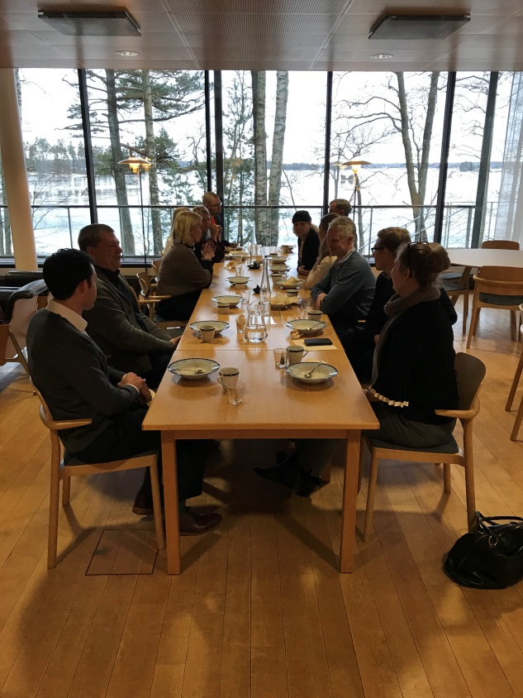
Who are we?
Started as a long-term Finnish collaboration of banks’ and large corporations’ Trade Finance (TF) experts
Now also including international set of members from various stakeholder groups
Several core TF financial institutions
Several large international corporations
TF technology/service and platform providers
TF interest groups and experts
FinTechs, technology developers, etc.
3
Notes:
NOTES HEADER IN UPPER CASE
2019-05-26
3

Slide 4
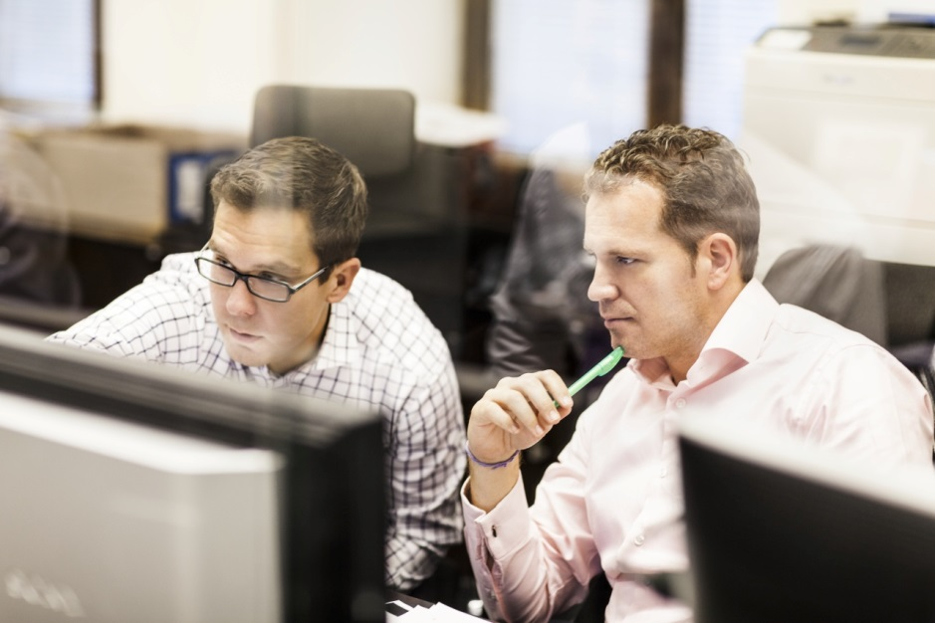
Why us?
Shared concerns and tested eagerness to make TF digital by renewing the business processes with standard semantics and new technology
Common and open forum for all TF stakeholder groups based on voluntary contribution of expertise
Started from Finland but rapidly growing to become global
4
Notes:
NOTES HEADER IN UPPER CASE
2019-05-26
4

Slide 5
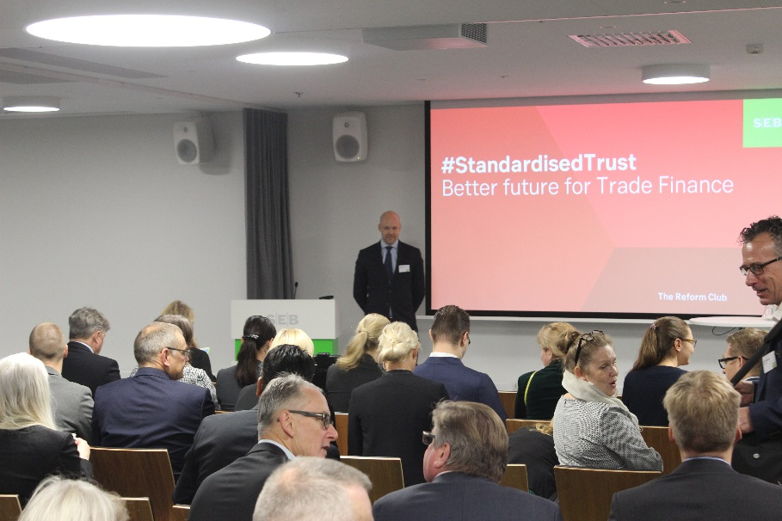
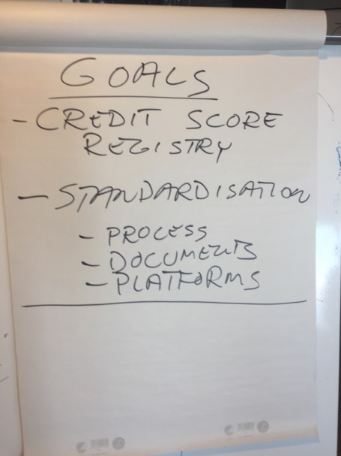
Standardised Trust Community
Common White Paper - Standardised Trust - and a LinkedIn community (now 278 members)
Standardised Trust Events started in October 2017
Four Working Groups started in June 2018 with 30 active members participating
Targeting to global expansion outside Europe
Community-wide quarterly meetings started in October 2018
Creation of common semantic model started with Bank Guarantees
www.standardisedtrust.com
5
Notes:
NOTES HEADER IN UPPER CASE
2019-05-26
5

Slide 6
Working Groups
WG #1, End-to-End processes
Review existing TF instruments and classify them per existing usability & defects and renewal capacity with the new tech
WG #2, Standards & Semantics
Semantics and common language for TF business and emerging tech needs
WG #3, Technology
Available and TF supporting new tech with becoming digital, not only digitalisation approach
WG #4, Liaisons
Engagement with the other existing TF digitalisation fora
6
Notes:
NOTES HEADER IN UPPER CASE
2019-05-26
6

Slide 7
First actual task: Guarantee
Agreed as the first prio by the WG1
Other WGs now supporting the task per expertise area
Aim to start defining a new, streamlined process
With simplified data and business model structure
Existing standard and technology initiatives mapped and then worked through by the community

